Slide 1
Tutorial-1
Gayan Perera

Slide 2
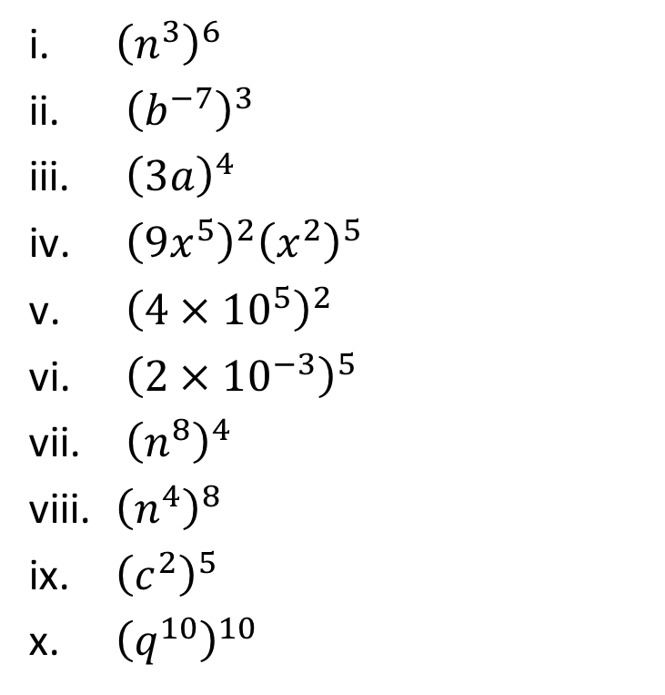
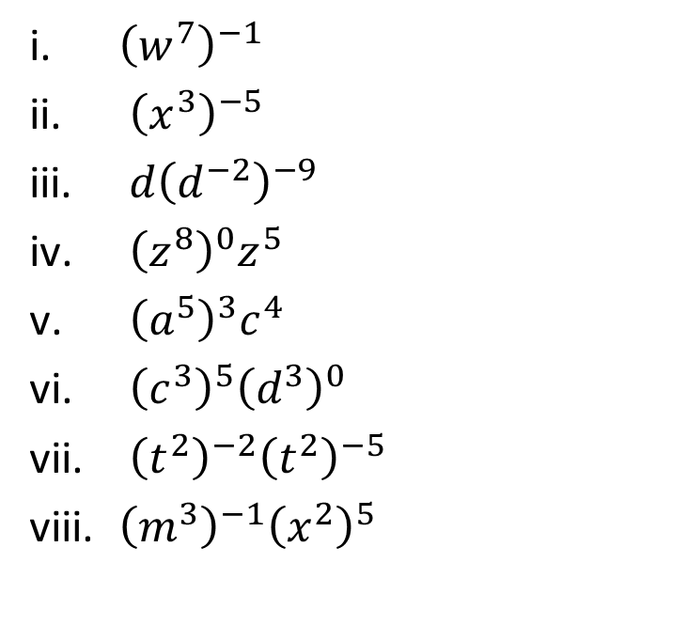
Tutorial-1
Q1) Simplify the following:
1.1 1.2

Slide 3
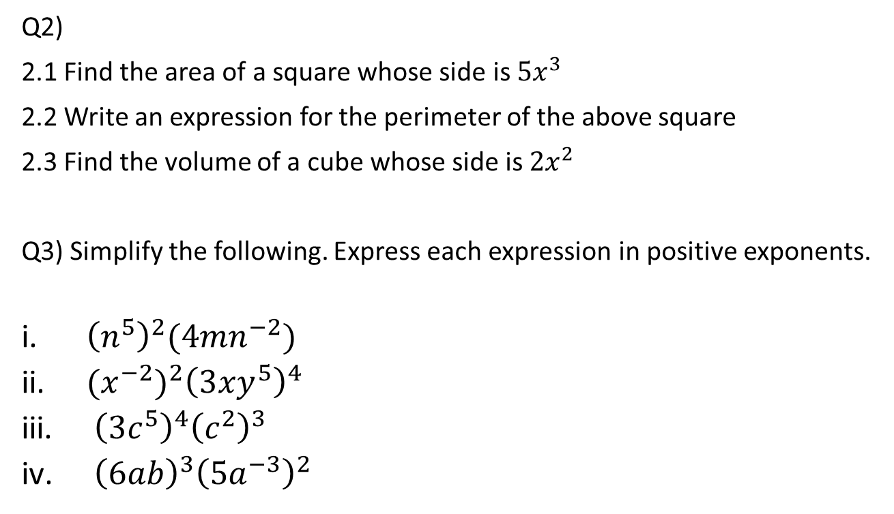
Tutorial-1

Slide 4
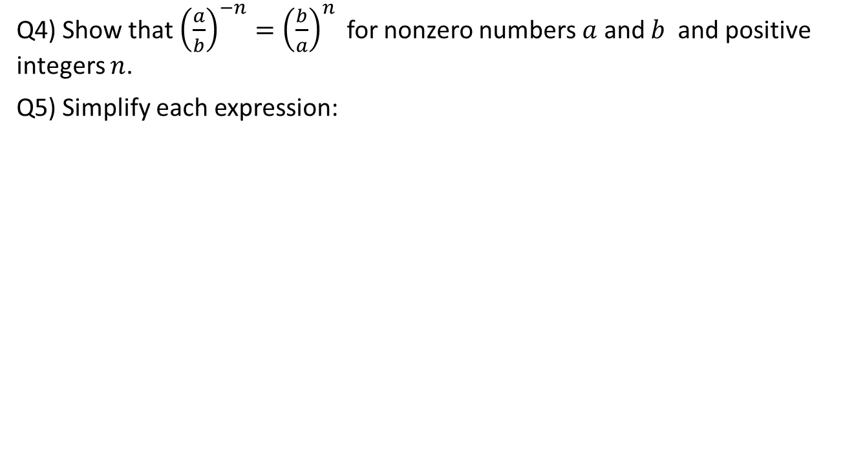
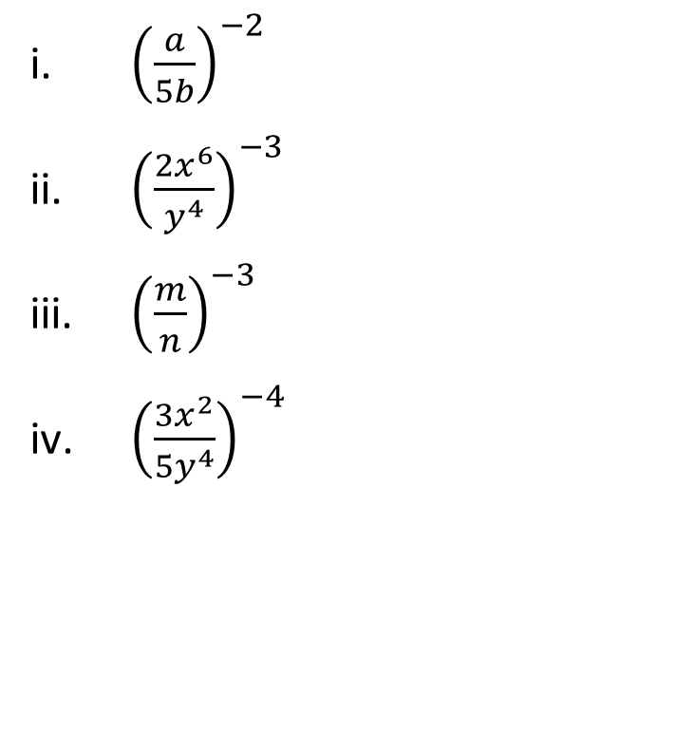
Tutorial-1

Slide 5
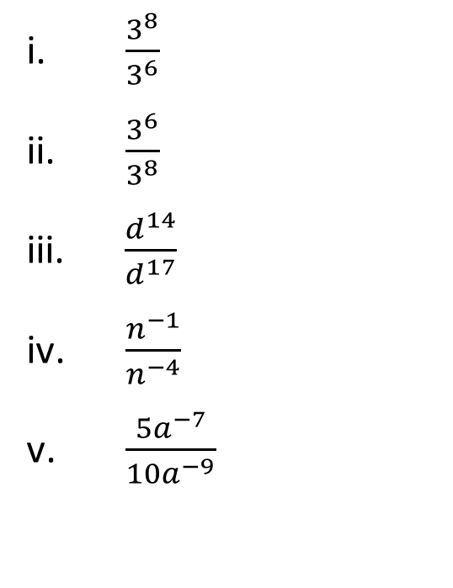
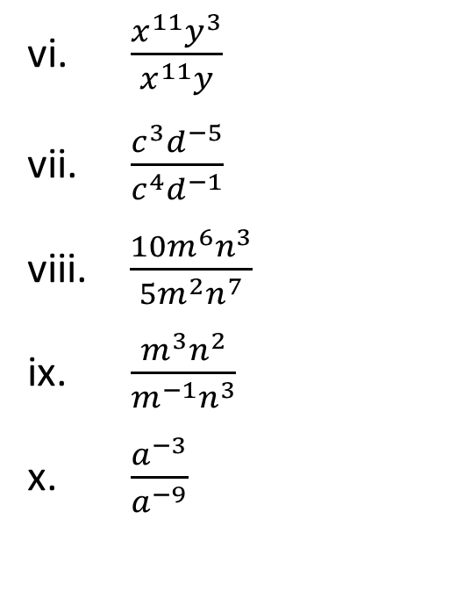
Tutorial-1
Q6) Simplify each expression:

Slide 6
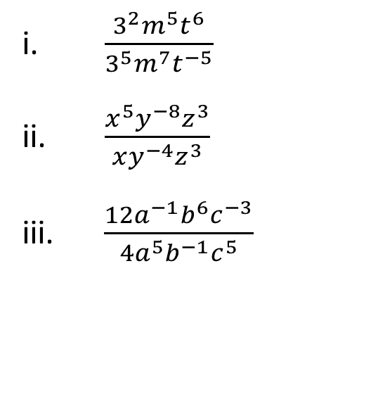
Tutorial-1
Q7) Simplify each expression:

